Slide 1
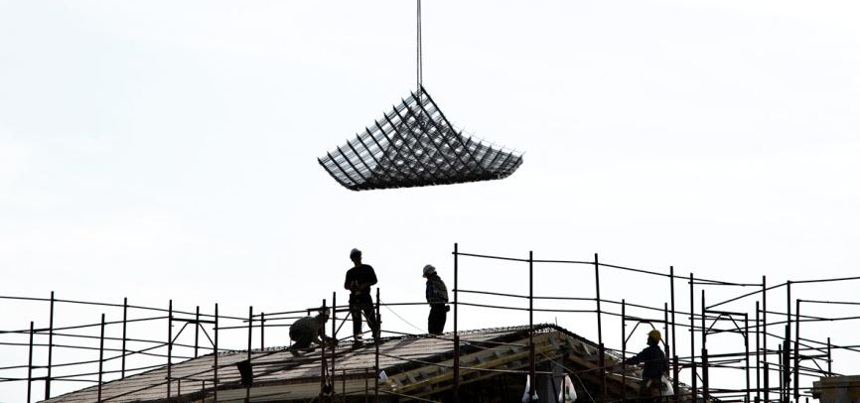
OiRA promotion
Lorenzo Munar
Project TOGETHER – builders of health
20th October 2016
Notes:
1

Slide 2
OiRA – The context
Over the years and despite the efforts, the task of assessing the risk is not universally spread and the quality of RA needs to be improved (especially among micro & small businesses)
A new generation of tools (IT-based, online, digital, …) has emerged
The use of internet and devices like computers, mobile phones, tablets has increased
Interactive risks assessment tools have been developed targeting micro and small companies
RI&E – OiRA (The Netherlands – EU-15 MS)
Besmart (Ireland)
Evalua-t (Spain)
Several tools (UK)
These tools are not presented as the SOLUTION, but as an opportunity to support - within the limits of any tool (traditional or online) - the effort carried out by public institutions, social partners and chambers of commerce to improve OSH among micro and small companies
Notes:
First bullet point:
Communication from the Commission to the European Parliament, the Council, the European Economic and Social Committee and the Committee of Regions on the practical implementation of the provisions of the Health and Safety at Work Directives 89/391 (Framework), 89/654 (Workplaces), 89/655 (Work Equipment), 89/656 (Personal Protective Equipment), 90/269 (Manual Handling of Loads) and 90/270 (Display Screen Equipment) pp.15-16 /* COM/2004/0062 final */http://eur-lex.europa.eu/legal-content/EN/TXT/?uri=CELEX:52004DC0062

Slide 3
ESENER-2 – Workplace risk assessments carried out regularly, by country (% establishments)
Base: all establishments.
Notes:
NB: slides about « reasons why risks assessments are not carried out regularly » were deleted, as the percentage is rather low (representativness)

Slide 4
ESENER-2 – Major reasons for addressing health and safety (% establishments, EU-28 and Slovenia)
Base: all establishments in the EU-28 and Slovenia.
Notes:
Results: weighted by estprop

Slide 5
Major difficulties in addressing health and safety (% establishments, EU-28 and Slovenia)
Base: all establishments in the EU-28 and Slovenia.
Notes:
Results: weighted by estprop

Slide 6
Reasons why workplace risk assessments are not carried out regularly, by size (% estab., EU-28)
Base: establishments in the EU-28 that do not carry out risk assessments regularly.
Notes:
Results: weighted by estprop

Slide 7
Challenge: reaching MSEs (and making them act)
When it comes to MSEs, one of the main challenges is simply to reach them
The “promotional” side of OiRA is critical for the project
The OiRA community is fully aware of this and is already addressing this issue by:
improving knowledge on this specific issue;
increasing the range of means/channels traditionally used to reach MSEs (by using/setting up new ones);
integrating OiRA in a more global strategy (and not as a stand-alone product).
OiRA promotional strategy 2014-2020 published by EU-OSHA, available at www.oiraproject.eu

Slide 8
OiRA Promotion / Dissemination - Key issue for the project
Even if we develop good quality tools they are useless if we do not manage to reach the end-users
Reaching them is the first challenge and make them use OiRA the second one
Low take up of OiRA by end-users is considered as a High Risk for the OiRA Project (risk assessment of the OiRA Project)
With the OiRA statistics we can monitor the use of the tools, so we know if the tools are used or not

Slide 9
OiRA promotion strategy at different levels
EU-OSHA has a two-fold promotion strategy:
OiRA project level
Promoting OiRA among OiRA target audiences/intermediaries (EU/MS social partners, Ministries/Labour Inspectorates, National OSH Institutes)
OiRA tool level (responsibility lies with EU/National developers)
Supporting OiRA partners to promote their tools

Slide 10
OiRA project level – Objectives
Properly promote the OiRA software/project among EU sectorial social partners and MS partners to increase the chances of them taking up the OiRA software and adapting it to national and sectoral needs.
To create media buzz and interest for the OiRA tool and its potential impact on improved security standards among European MSEs.
To generate extensive media coverage about the OiRA tool among specialised OSH press.
To provide a long-term constant online source of information and knowledge about the project and the possibility of having an online community.

Slide 11
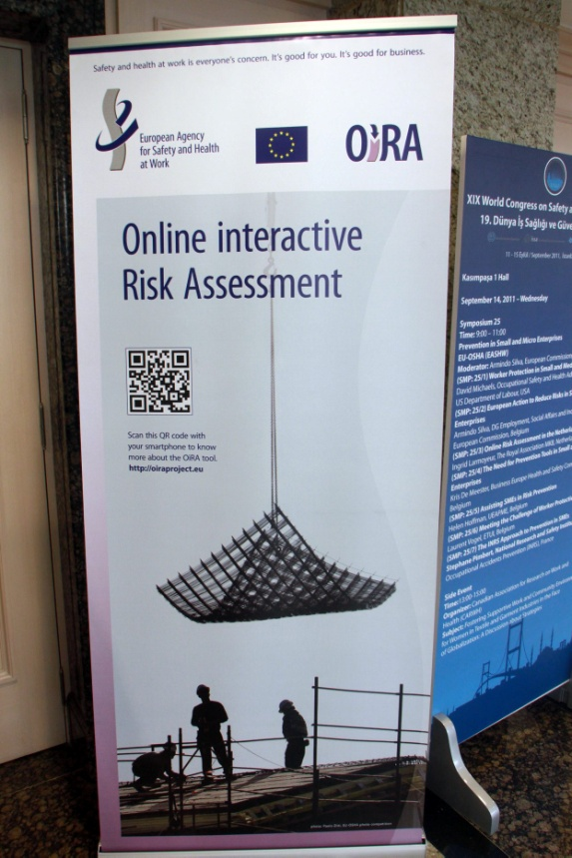
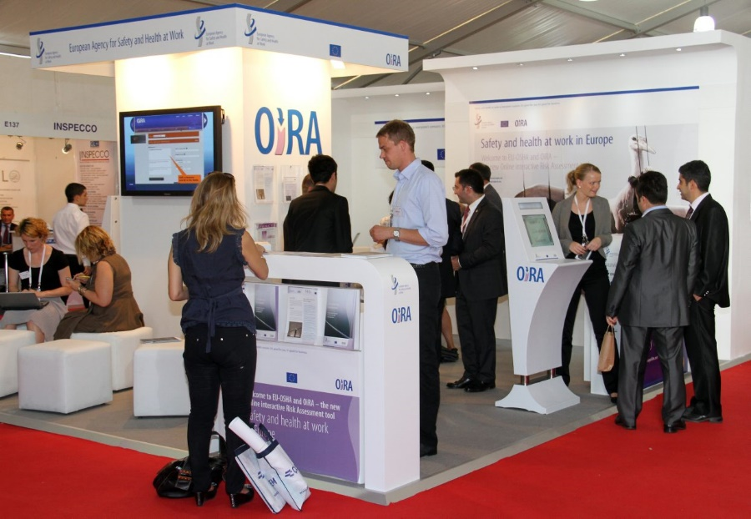
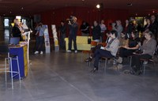
OiRA project level – Activities carried out
Presentations in different fora: (SLIC meetings, EU sectoral social dialogues meetings, National stakeholders (Ministries, Labour Inspectorates, social partners, …).
Organisation of information seminars to explain the OiRA project to potential partners. The idea is to provide them with a good overview of the project so they can decide about joining the OIRA community.
Website providing up-to-date information and knowledge on the OiRA project.
Publication of press releases and articles in specialised OSH press.

Slide 12
OiRA Overview - promotion
Partners developing promotion strategies / products for each tool / sector many based on the OiRA promotion/supporting documents produced by EU-OSHA

Slide 13
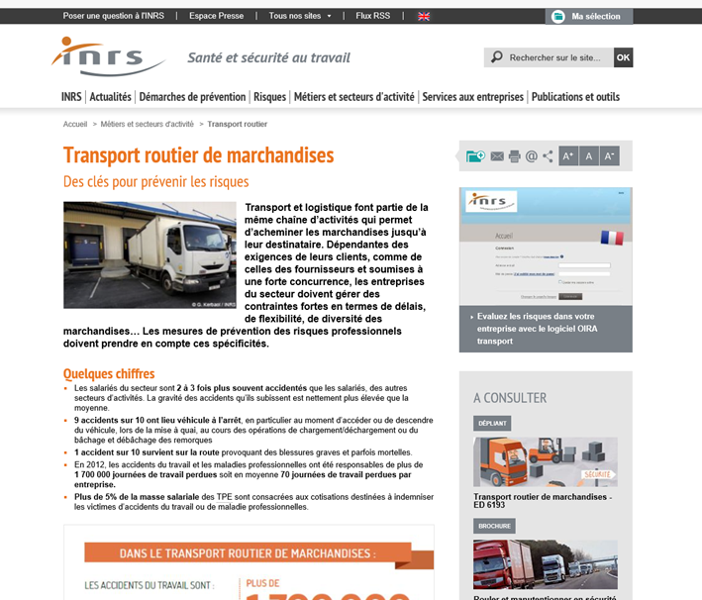
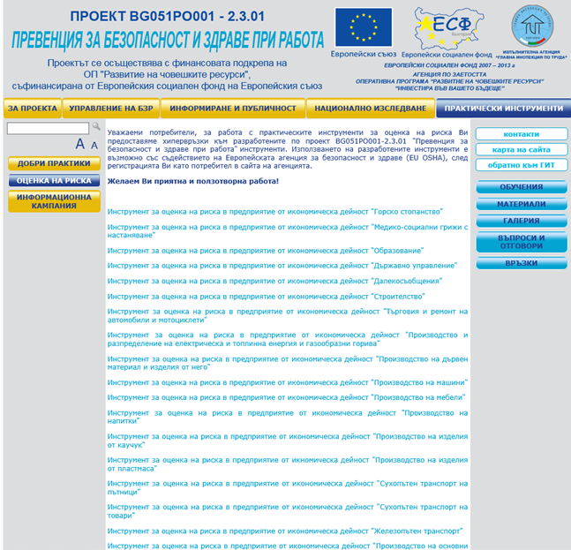
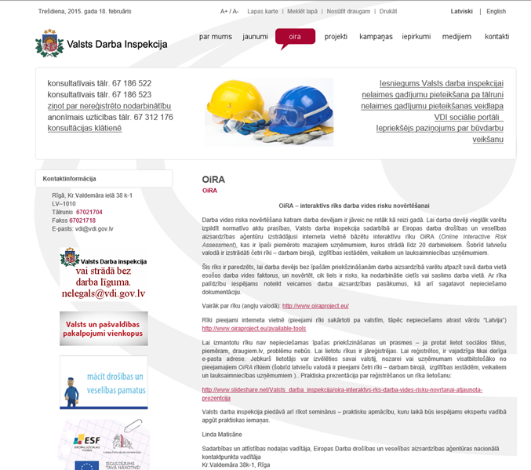
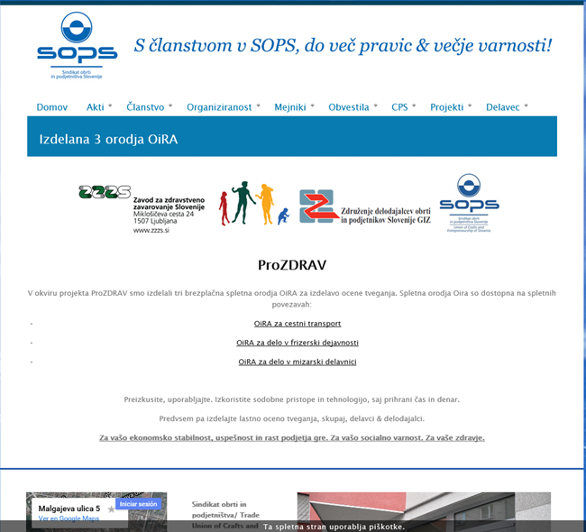

Slide 14
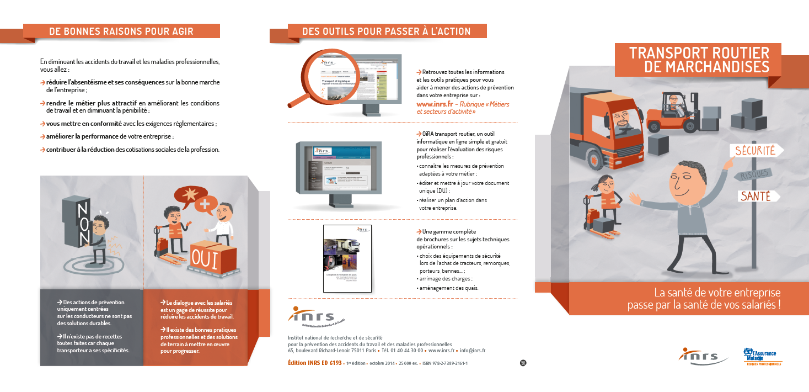

Slide 15
OiRA tool level – Objectives
Encourage and guide OiRA partners in the process of setting up an OiRA promotion policy
Include OiRA in the Agency’s Portfolio approach (in terms of promotion)

Slide 16
OiRA tool level – promotional resources (some can be adapted at National/Sectoral level)
OiRA clips / videos
OiRA case studies – Cypriot example: At the cutting edge of risk assessment
OiRA infographics – an easy and visual way of explaining how the OiRA process works from inputs to final outputs.
To be added to the existing ones:
The OiRA website
Tailored PowerPoint presentations
OiRA guide (intended to Policy Makers)
OiRA FAQ (Frequently Asked Questions)
OiRA roll-up banners
OiRA bookmarks (including also the QR code)
Available at: http://www.oiraproject.eu/

Slide 17
OiRA tool level - promotional resources, contd.
The OiRA promotion guide

Slide 18
OiRA tool level - Why the Promotion guide?
If tools are not properly promoted they will not reach MSEs. The importance of “promotion” has been raised in the OiRA RA:
Low take up by end-users is a high risk for the project
Actions needed:
Encourage / invite the OiRA partners to think about the promotion of their OiRA tools (even before starting to develop their tools).
Develop the OiRA promotion guide to help OiRA partners to promote and ensure that MSEs are aware of the existence of OiRA tools and are “invited” to use them
Put promotional resources at the disposal of the OiRA partners to help them in the task of promoting their tools and finance promotional events once a tool has been published/finalised.

Slide 19
OiRA tool level - Why the Promotion guide?
OiRA is an innovative product for most of our OIRA partners
Action needed
Help/guide our partners throughout the different steps of a successful implementation strategy: adoption, implementation, continuation
Some of our OiRA partners lack the competences/resources to set up a “promotion strategy” without some kind of support/guidance
The OiRA promotion guide is an attempt to contribute to address these challenges faced by the OiRA project as a whole and most specifically by the OiRA partners.

Slide 20
OiRA – as a project – encourages …
Setting up a promotional strategy for each single tool / sector
Conduct insight research of the target audience before carrying out any promotion actions.
Use the relevant partners/channels to reach the target audience.
Adapt the “messages” to each specific sector.
Planning a campaign and not just individual and isolated actions
Adding new communication channels (Twitter, Facebook, LinkedIn, etc.) to the traditional ones
Using influencers, large multipliers
Sending the “correct” messages to micro and small enterprises (adapting them to each specific sector)
Disseminating the tools through personal contact

Slide 21
OiRA – as a project – encourages …
Foster the exchange of OiRA promotional material among OiRA partners
Develop a new OiRA website (launched 1Q 2017) intended to OiRA partners
Resources / OiRA promotion material section with products produced by EU-OSHA or National OiRA partners

Slide 22
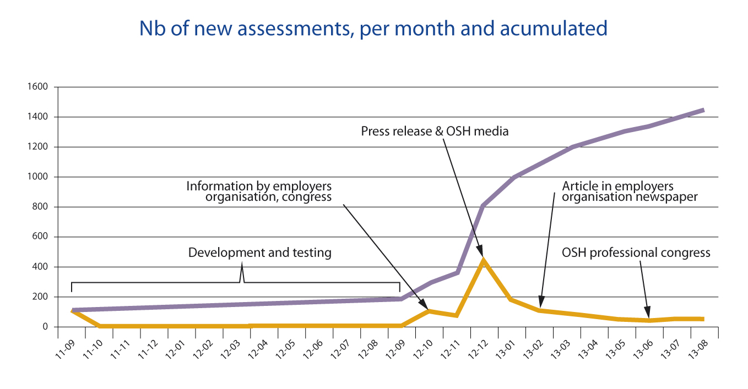
Offer the possibility of monitoring the use of such tools
Numbers of OiRA users accounts created: 34.834 (17/10/2016)
Number of RA created: 48.183 (17/10/2016)
Better assess the impact of promotional activities carried out
Statistics OiRA France - INRS

Slide 23
Monitor your impact
Mailing
(leaflet)

Slide 24
More information:
http://www.oiraproject.eu
Contact:
Lorenzo Munar munar@osha.europa.eu

